Slide 1

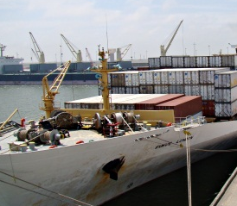
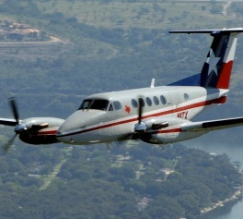
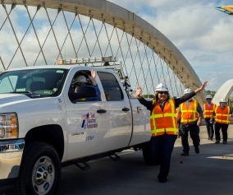

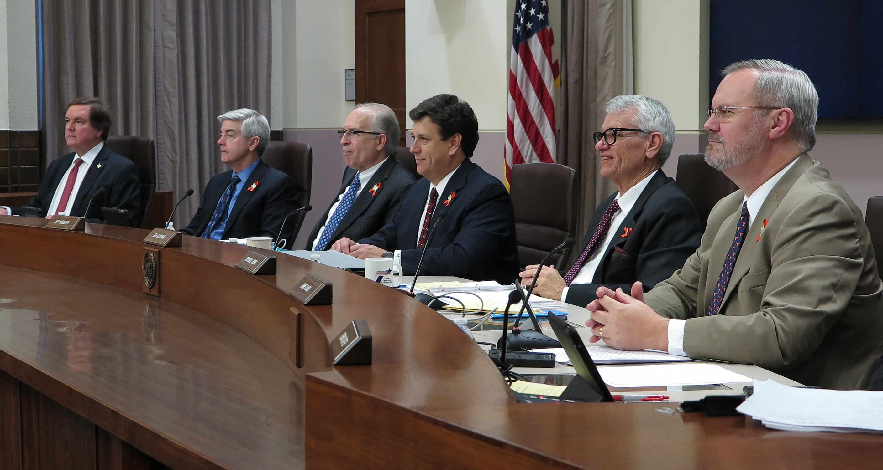
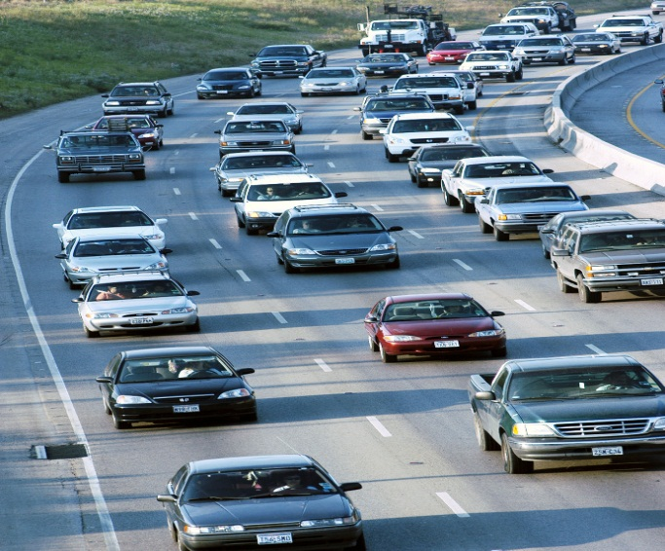
Freight and international trade on the Texas-Mexico Border - challenges and opportunities
Rice University – Baker Institute
August 24, 2016

Slide 2
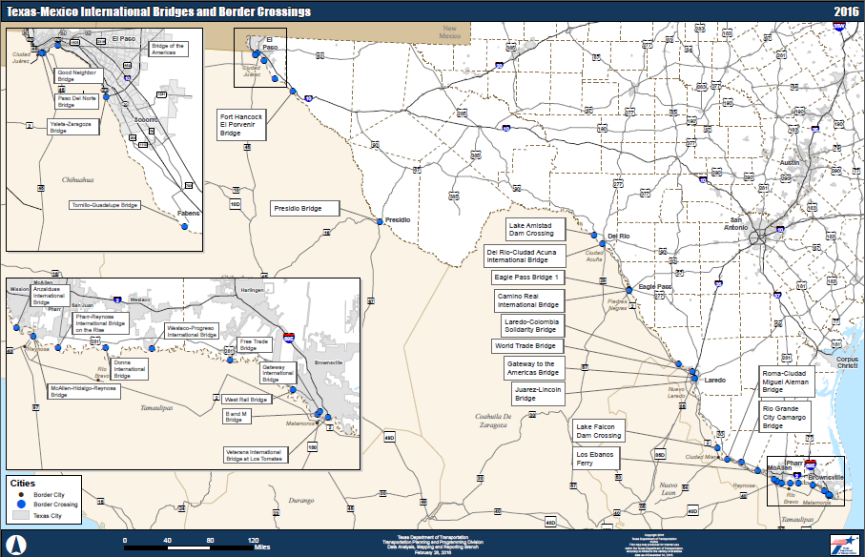
Overview of Texas-México Border Crossings – 28 Crossings
Notes:
Texas has more border crossings and a longer border than any other southern border state.

Slide 3
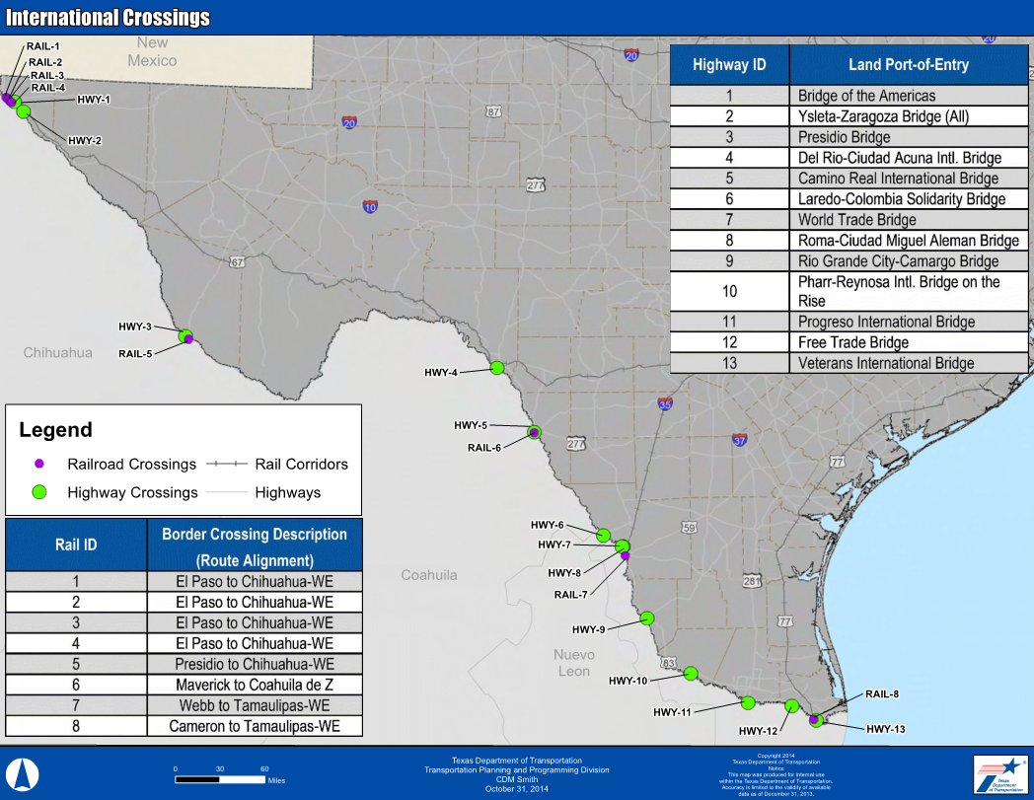
Texas-Mexico Rail and Truck Border Crossings
Notes:
Texas has 29 Border/POEs and 13 are Commercial

Slide 4





Why is the Texas –Mexico Border Important?
Ranking | Country | Dollar Amount | % Share of Exports
1 | Mexico | $ 94,456,000 | 35.7%
2 | Canada | $ 23,853,000 | 9.0%
3 | China | $ 10,306,000 | 3.9%
4 | Brazil | $ 10,036,000 | 3.8%
5 | Netherlands | $ 9,612,000 | 3.6%

Slide 5
US-Mexico Value of Trade – 2005-2015
Trade with Mexico is a Major Part of the Texas Economy
Notes:
Trade with Mexico is a major part of the Texas economy (Figure showing Texas-Mexico trade)
It creates a significant number of jobs in Texas (Data showing number of trade-related jobs supported by Texas)
Its benefits are experienced throughout the state, not just the border region – Figure showing Mexico export trade with select Texas MSAs)
It diversifies our state’s economy and it is one of the reasons that it continues to grow – Look for statistics showing trade’s share of the Texas economy

Slide 6

Economic Importance of the Texas-México Border
Total US – Mexico trade was $ 507 billion of which $ 245 billion (imports/exports) moved through Texas Border POEs by truck
74% ($245 billion) of US-Mexico trade moves through Texas Ports-of-Entries
Mexico is Texas’ largest export market with $100.9 billion or 36% of Texas’ total goods exports
Mexico is Texas’ #1 trading partner with almost $196 billion, or 35.7% of total U.S.-Mexico trade
74.4% of trade comes trough Texas POEs
  80.5% by truck
  19.5 by rail

Slide 7
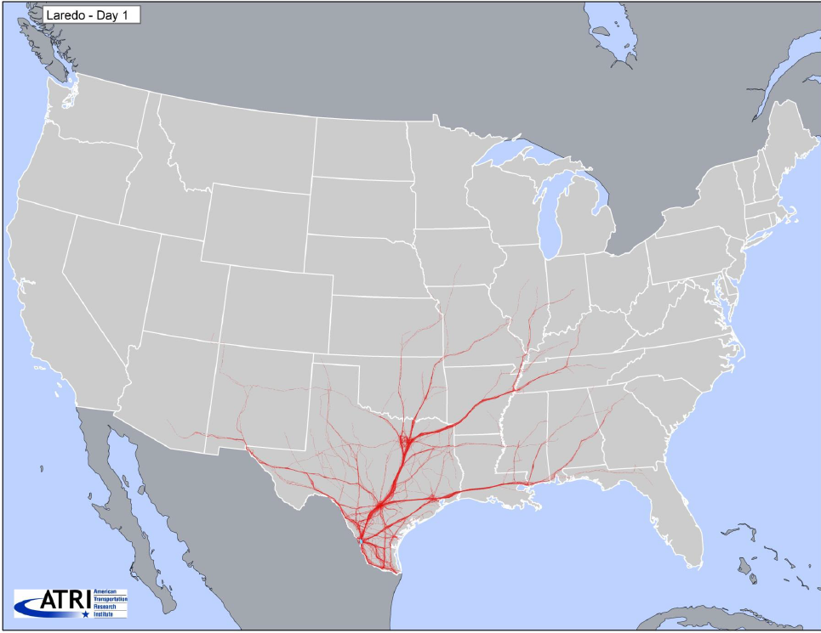
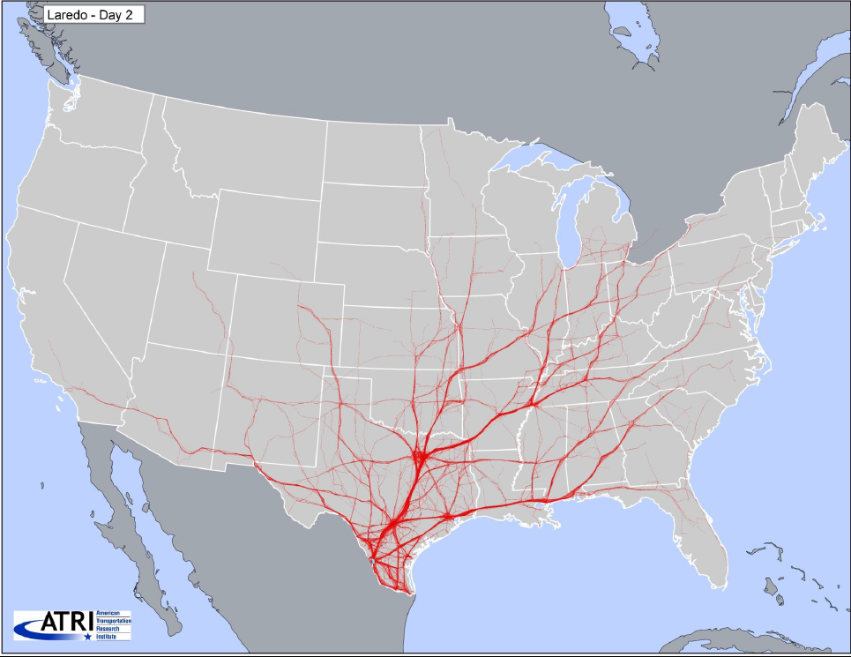
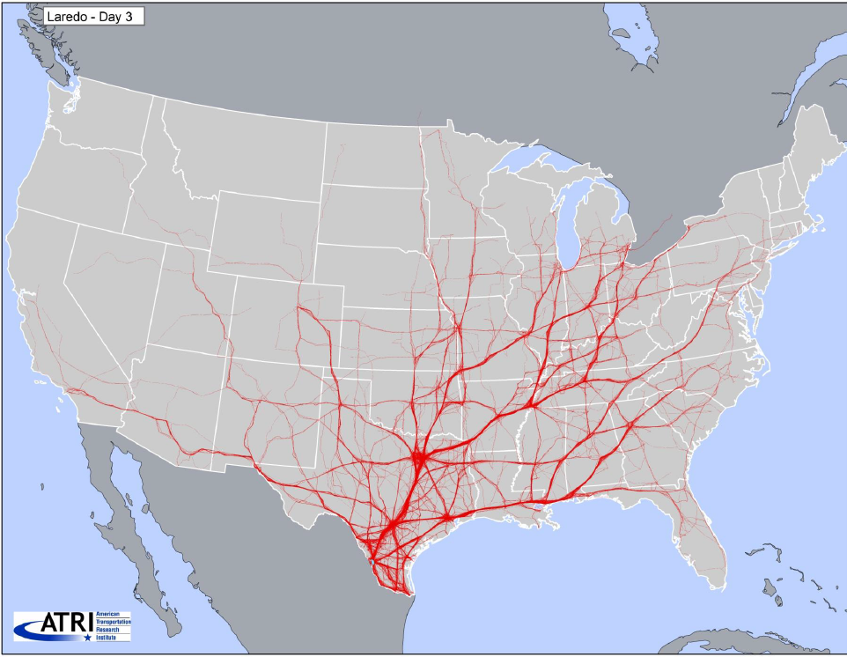
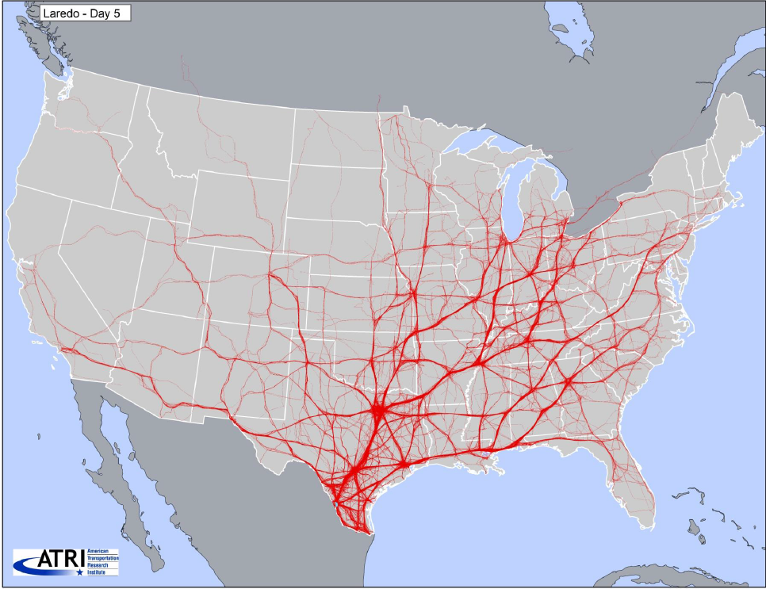
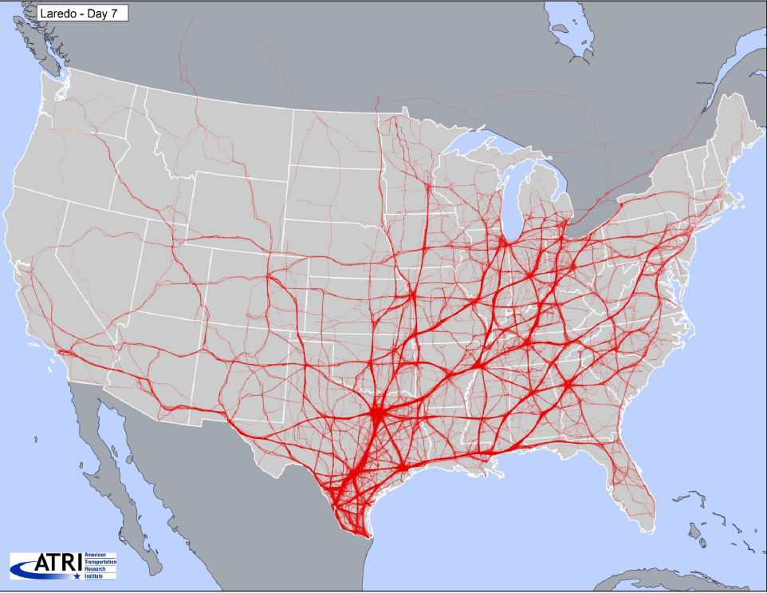
National Impact of Texas-Mexico Border - Laredo

Slide 8
Texas-Mexico Northbound Truck Crossings – 2005-2015

Slide 9
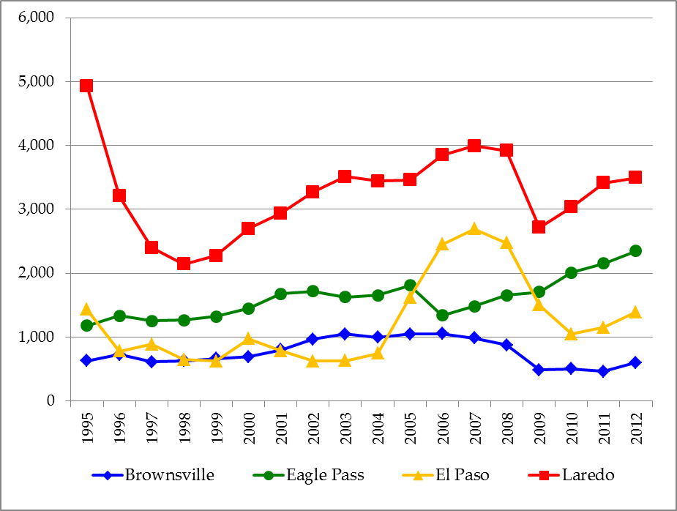
Train Crossings at Texas Border
Source: U.S. Department of Transportation, Research and Innovative Technology Administration, Bureau of Transportation Statistics, Border Crossing/Entry Data

Slide 10
Where does the Rail Traffic “Flow” in Texas?
Source: Cambridge Systematics, 2007
Notes:
10

Slide 11
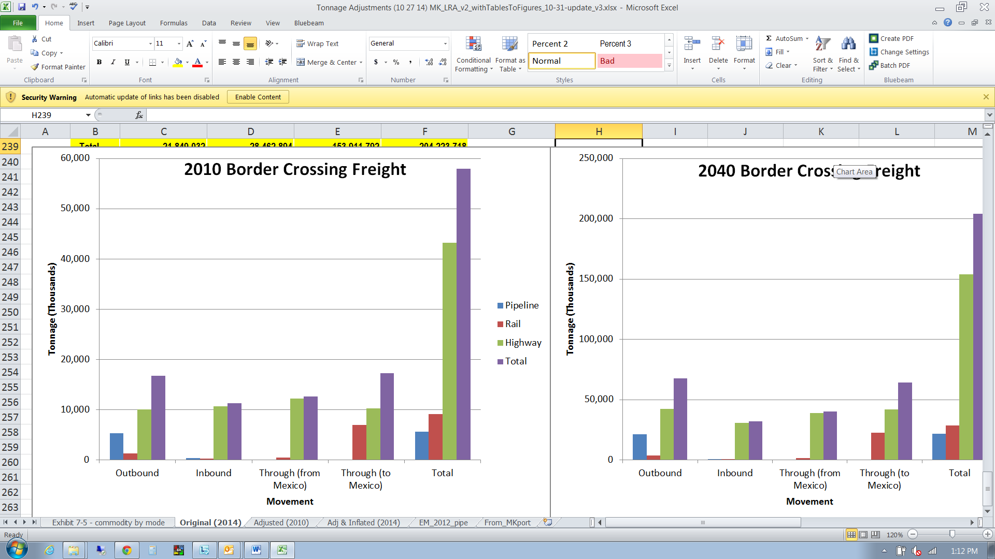
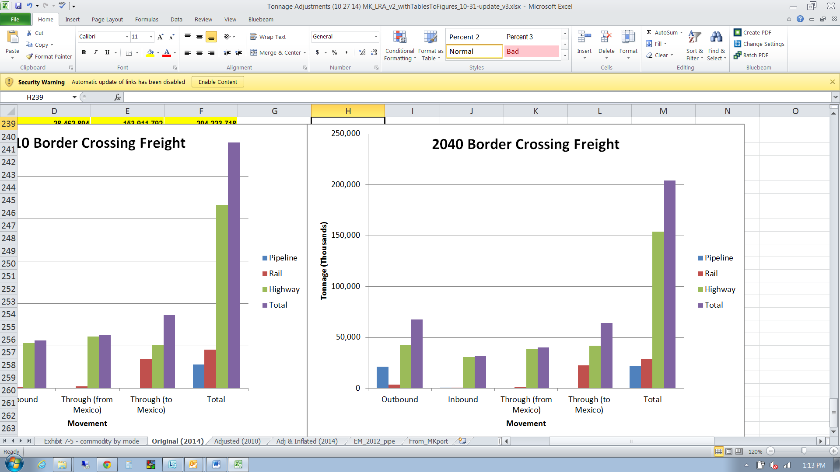
Texas Border-Crossing Freight Tonnage 2010 and 2040
  Nearly 58.0 million tons of freight crossed the Texas-Mexico border in 2010 and over 204.2 million tons are estimated to cross the border in 2040

Slide 12
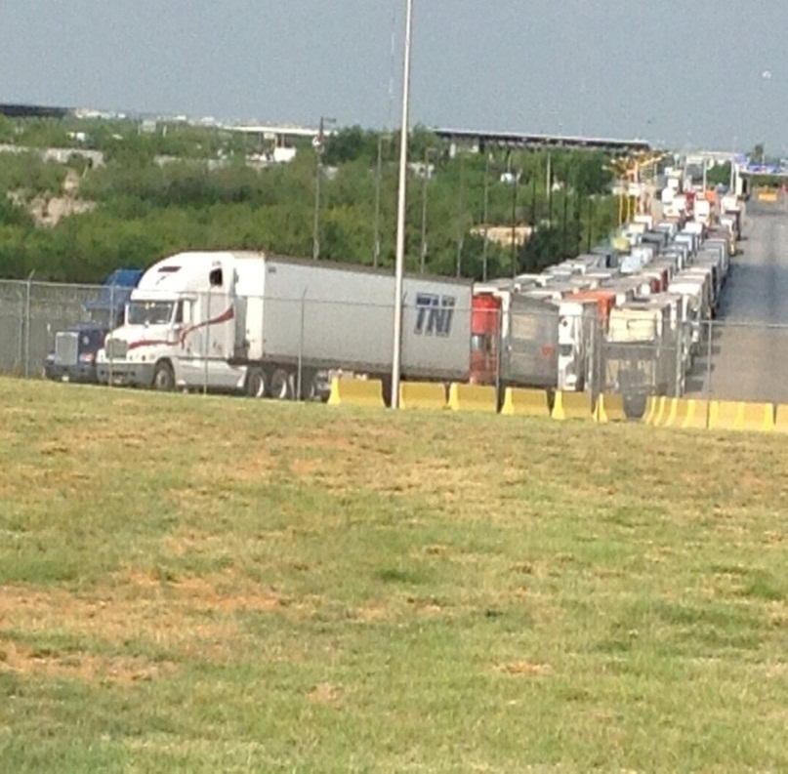

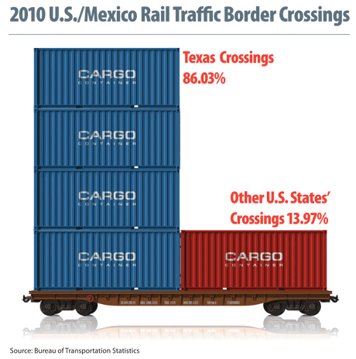
Texas-mexico border challenges

Slide 13
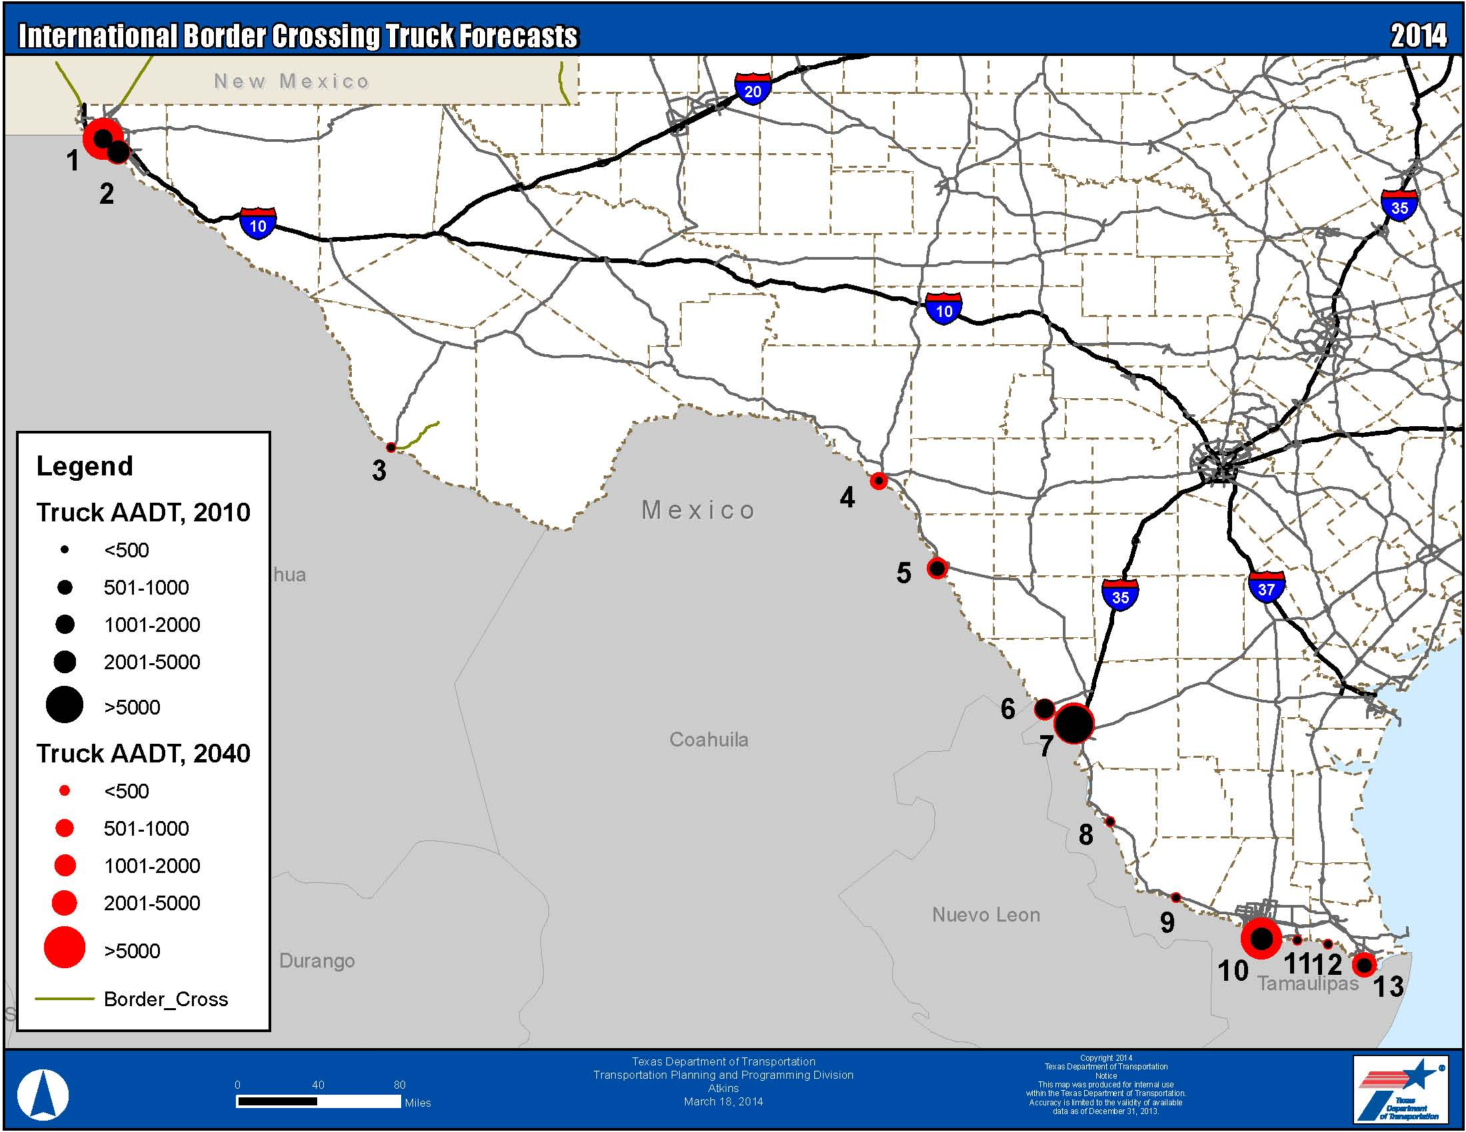
Texas-Mexico Truck Border Crossing Forecasts 2010 - 2040
2040 Highest Freight Volumes:
  Laredo World Trade Bridge
  Pharr-Reynosa International Bridge
Highest Growth Rates 2010-2040
  Laredo World Trade Bridge (4.6%)
  Pharr-Reynosa International Bridge (2.4%)
  Veteran International Bridge (1.7%)
Notes:
The highest forecasted freight volumes for the forecast year 2040 are still on the World Trade Bridge in Laredo and the Pharr-Reynosa International Bridge on the Rise in Pharr.
The cities with the highest freight volumes are in Laredo, Pharr, and El Paso (Exhibit 72). The Laredo bridges continue to have the highest truck-to-automobile ratios. The highest growth rates of international border crossings from 2010 to 2040 are at the Veterans International Bridge in Brownsville, the Pharr-Reynosa International Bridge, and the World Trade Bridge.

Slide 14
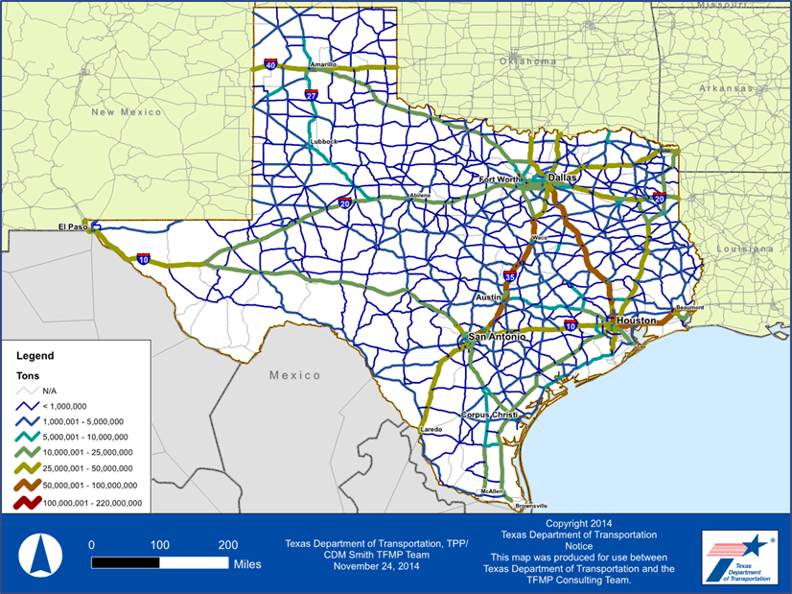
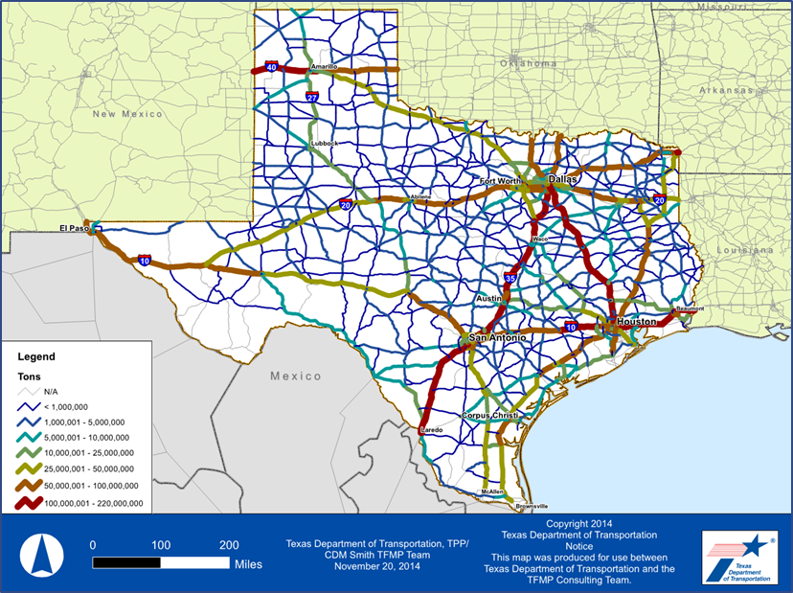
Growing Congestion: Highway Freight Tonnage, 2010 to 2040
Notes:
In 2014, approximately 2 billion tons of freight moved by all modes in, out, through and within Texas and highways accounted for 1 billion tons.
By 2040, we expect to see a significant increase in truck freight volumes on the Texas highway system. The amount of freight transported by truck on our highway system is anticipated to double from 1 billion tons in 2014 to approximately 2.2 billion tons in 2040, over a 110% increase.
You can see from the dark red and brown areas on the graphic where we expect to see the most volume. All the Interstate corridors will experience an increase.

Slide 15
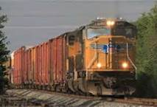
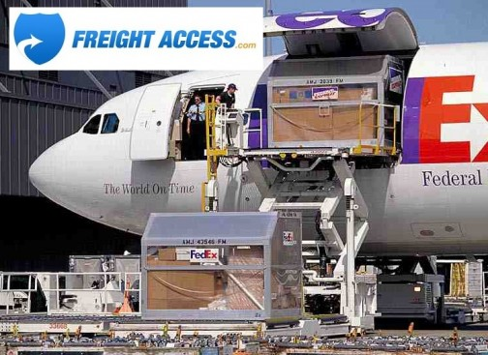
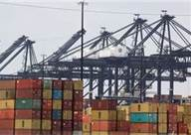
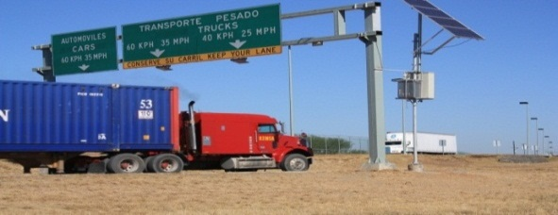
Key Texas Border Transportation Challenges
Growing trade volumes between U.S. and Mexico through Texas
Inadequate system capacity at the border and beyond the border
Systems operations issues at the border and beyond the border
Connectivity issues from border to rest of the state
Institutional/interagency- industry coordination
Education and public awareness
Funding challenges
Notes:
15

Slide 16

Texas Border Transportation Challenges
Lack of a coordinated border strategy
  No single entity is responsible for border coordination
Congestion at the Border
  Impacts efficiency of freight movement
Border crossing staffing issues
  Impacts customs processing time and wait times
Hours of operation at Port of Entry needs to be extended
Technology deployment
  Need to apply technology at Port of Entry to improve mobility at the crossings
Excessive inspection is impacting freight growth at the Brownsville Port of Entry
Notes:
Lack of infrastructure and staffing at existing bridges where traffic from Mexico crosses, which results in delays as train stops to wait for inspections

Slide 17
Texas Border Transportation Challenges
Inadequate highway and rail capacity
  Need for more rail bridge crossing at the border
  Need for greater north-south connectivity to the border
Understand what is happening in Mexico
    Multistate coordination - need to engage other states on benefits of Texas-Mexico border

Slide 18

Texas-mexico border – Addressing the Challenges

Slide 19

Freight Plan Policy Recommendations - Border
Texas as a North American Trade and Logistics Hub and Gateway
  The State should continue to invest in strategic transportation solutions that will enable Texas to maintain its position as the nation’s leader in North American trade and a leading international trade gateway and national logistics hub.
  Elevate the importance of economic and transportation benefits of freight movement in statewide, regional, and local transportation planning efforts
International Border/Ports-of-Entry
  The State should invest in and facilitate international border coordination strategies to improve freight mobility and efficiency.
  The state should explore creating a border entity charged with coordinating Texas-border strategies and initiatives
  The State should invest in a comprehensive integration of security and cross-border efficiency to improve cross-border trade and the movement of people and goods in order to facilitate Texas’ economic competitiveness

Slide 20
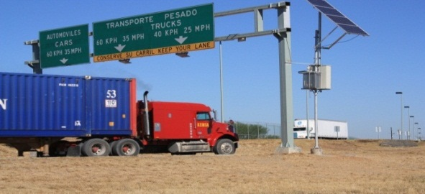
Freight Plan – Program Recommendations—Border
Work with federal, state, local, and private sector to develop a dedicated International Border Freight Movement Coordination Program between industry and international, national, state, regional, local agencies
  Expand the FAST (Free and Secure Trade) program, and the proposed express lane at the Department of Public Safety (DPS) inspection stations
  Pursue one-stop permitting and inspection between US Customs and Border Protection (CBP), FMCSA, TxDMV, and DPS
  Improve coordination between all appropriate state, national, and international agencies to define and collect data and information necessary to understand issues and develop solutions
  Consider funding partnerships with US and Mexican agencies and industry partners
  Develop and implement a matrix for measuring efficiencies and benefits
  Collaborate to expand trusted shipper programs/ prescreening

Slide 21
Freight Plan – Program Recommendations—Border
Work with federal, state, local, and private sector to develop a program to analyze current efficiencies at international freight border crossings
  Work with federal, state, local, and private sector to facilitate and incorporate proven technology-based solutions for international freight border crossings
  Maintain security while increasing trade throughput
  Implement advanced ITS for border trade commercial shipments
  Implement a CMV Safety Data Exchange
  Increase the ROI for Commercial Security investments
  Increase use of Electronic Credentialing
  Establish Virtual Weigh Stations at appropriate locations

Slide 22

Summary
Texas will continue to be an important player in U.S. international trade, serving as the main gateway for trade with Mexico
Addressing Border Transportation Challenges will require a comprehensive and coordinated strategy
Trucks will continue to dominate mode of trade movement
Maintaining and growing trade relationship with Mexico relies on maintaining adequate capacity and increasing efficiency of the Texas transportation network
Notes:
“One Texas, One Border, Many Challenges”

Slide 23
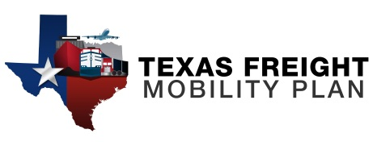
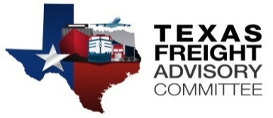
Questions?
Caroline Mays, AICP
Director, Freight and International Trade Section
(O) 512-486-5059
(C) 512-658-2436
Caroline.mays@txdot.gov
www.MoveTexasFreight.com

