Slide 1
Perspectives on Mexican Brain Drain
Nestor Rodriguez
The University of Texas at Austin

Slide 2
The Search for STEM
National Defense Education Act of 1958
1980s/1990s demand for skilled labor
Department of Defense concern with lack of STEM majors
Issue of security clearance for foreign-born scientists and engineers
Promote STEM for women and racial minorities

Slide 3
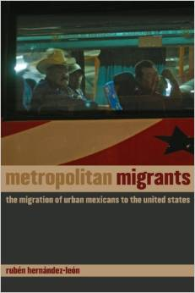
The Unit of Analysis
Nation-state vs. regional economy
US-Mexico transregional development
Houston-Monterrey Connection
Industrial restructuring in Monterrey and skill migration to Houston
Skill re-socialization of regions connecting US and Mexican spaces
For some regional occupations the border loses its social and cultural holding power
Business and labor strategies based on the international region, not the nation-state
Migration creates regions and markets that extend and merge non-political boundaries of nation-states

Slide 4
Houston—Monterrey Connection
Economic restructuring in Monterrey heavy Industry sector in 1980s and 1990s
Change in Mexico from import substitution to export production
NAFTA, foreign investment, downsizing
Weakening of labor codes protecting workers
Emigration of skilled and semi-skilled manufacturing workers to Houston

Slide 5
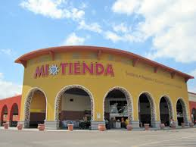
Brain trans-regionalization – a third dimension
Mexican professionals providing services to Mexican citizens outside Mexico
Ethnic communities (Tidwell, North Airline, West Little York, , Aldine Westfield)
Spanish-language media
Immigration lawyers
Physicians, nurses
Dentists
Religious personnel (Catholics, Protestants)
Etc.

Slide 6
Return Migration to Mexico
Exporting/deporting skills abroad
Mexicans returning to Mexico
314,904 Mexicans deported in FY2013
Significant numbers have skills
Call centers in Mexico and El Salvador
Hagan et al. (2015): 31 percent of returning migrants underwent mobility to a higher skilled job
Retail and hospitality
Shoe, leather, textile manufacturing
Services
Construction

Slide 7
Specialization in the world-system
Historical specialization in the world economy (global cities)
Global capital and manufacturing cities
Amsterdam and Leyden in 1600s
London and Manchester in1800s
New York and Houston in 1900s
Greater resources for economic success and professional career development
Attraction for gifted
“Better brain drain than brain down the drain” (student from India)

Slide 8
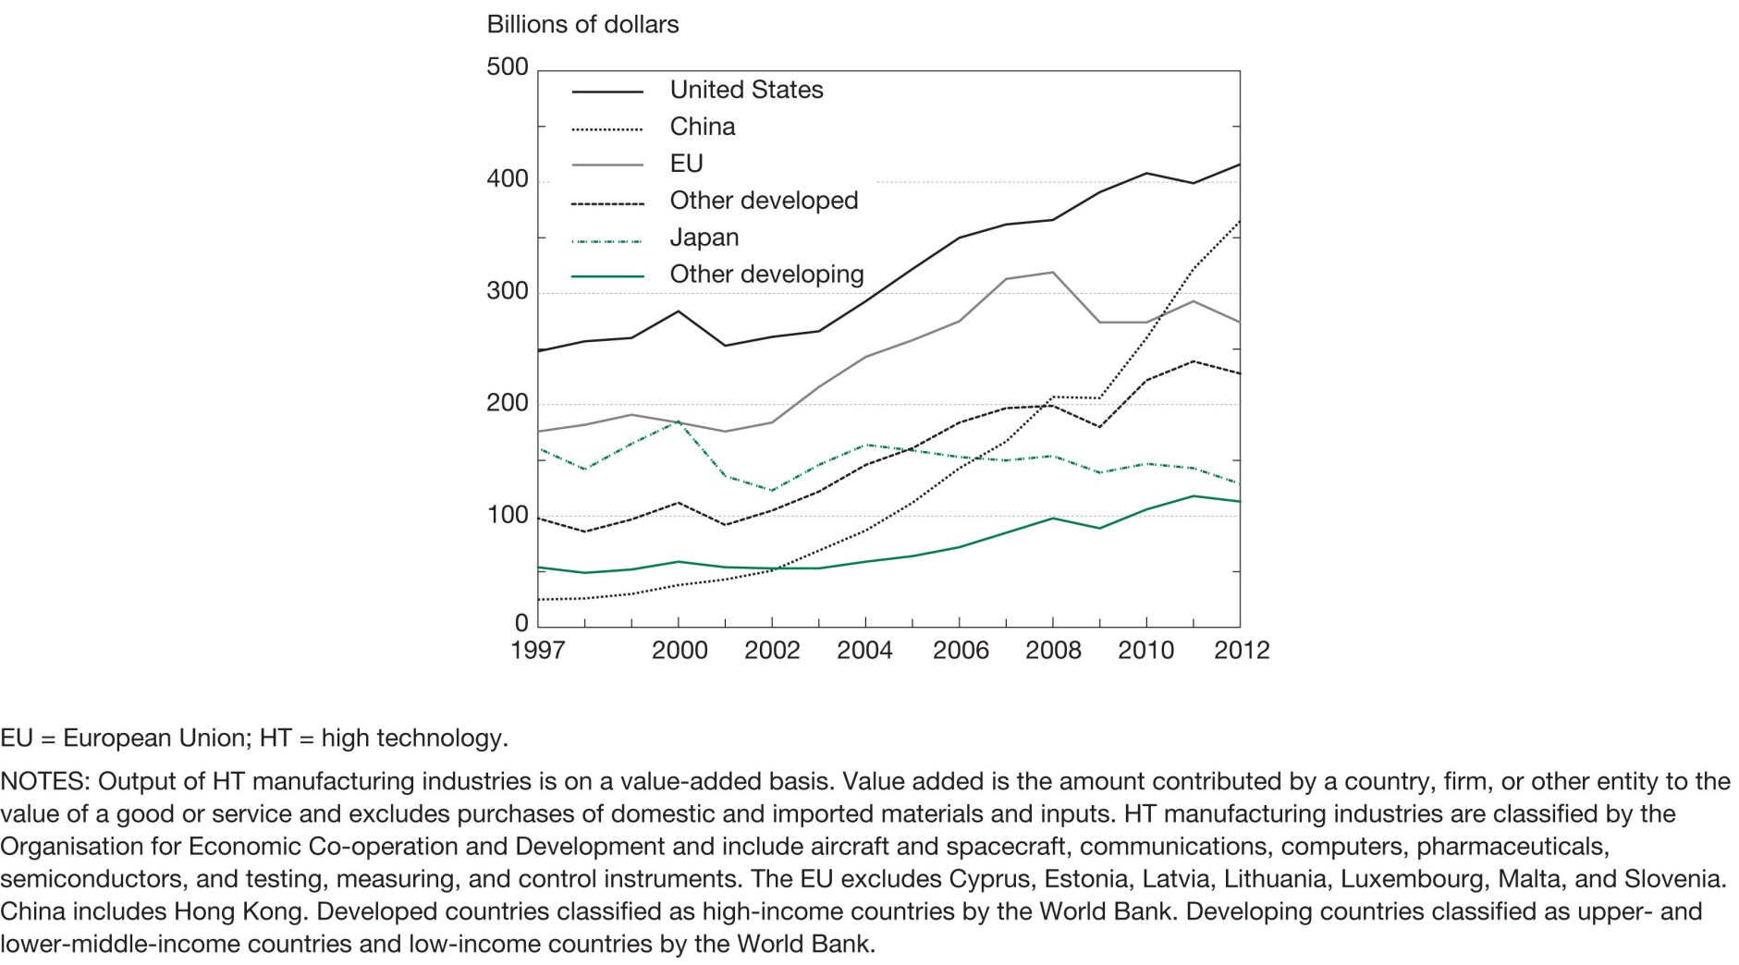
Output of HT manufacturing industries for selected regions/countries/economies: 1997–2012

